Slide 1
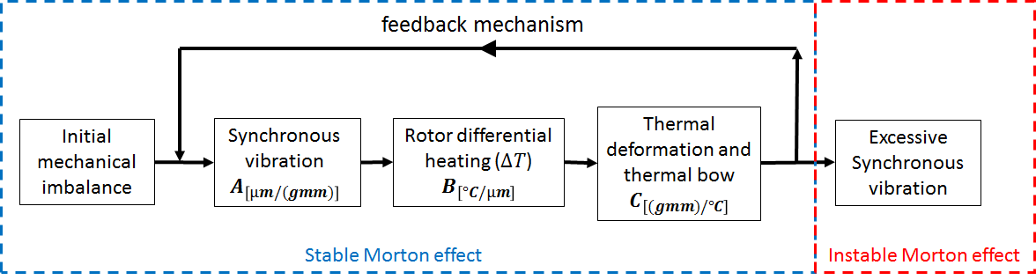






$$U_{m}, Z^{0}, {\dot{Z}}^{0} ,T_{rotor}^{0},T_{pad}^{0}$$
$F_{imbalance}$ = centrifugal force ($U_{m}, U_{ther}, t_{dynamic})$
$F_{brg}$ = Generalized Reynolds Equation($Z, \dot{Z},t_{dynamic}$)
$q_{rotor}^{n},q_{pad}^{n}$ = 3D energy equation($T_{rotor}^{n},T_{pad}^{n})$
$$M\ddot{Z}=F_{brg}+F_{imbalance}+F_{gravity}$$ Newmark-beta algorithme
No
Convergence of orbit
(shooting method)
Yes
${q_{avg}}_{rotor}^{n}$= time-averaging approach of heat flux
$$t_{n+1}=t_{n}+ ∆t_{thermal} \left(∆t_{thermal}=100T_{period}\right)$$
$T_{rotor}^{n+1}, T_{pad}^{n+1}$ = transient heat condunction model (${q_{avg}}_{rotor}^{n}$, ${q_{avg}}_{pad}^{n}$, $t_{n}$)
$U_{ther}^{n+1}$ = computation of the thermal imbalance ($T_{rotor}^{n+1}$)
$$t_{n+1}≤t_{end}$$
Yes
$$End$$
No

Slide 2
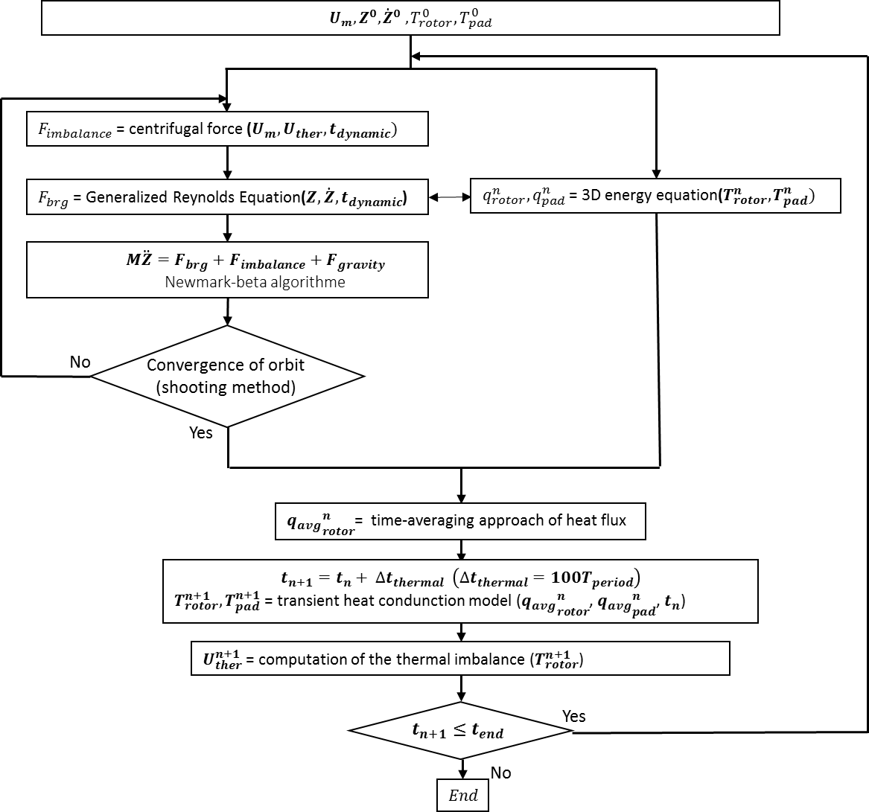



Synchronous vibration
$$A_{\left[µm/(gmm)\right]}$$
Rotor differential heating ($∆T$)
$$B_{\left[°C/µm\right]}$$
thermal imbalance
$$C_{\left[(gmm)/°C\right]}$$

Slide 3
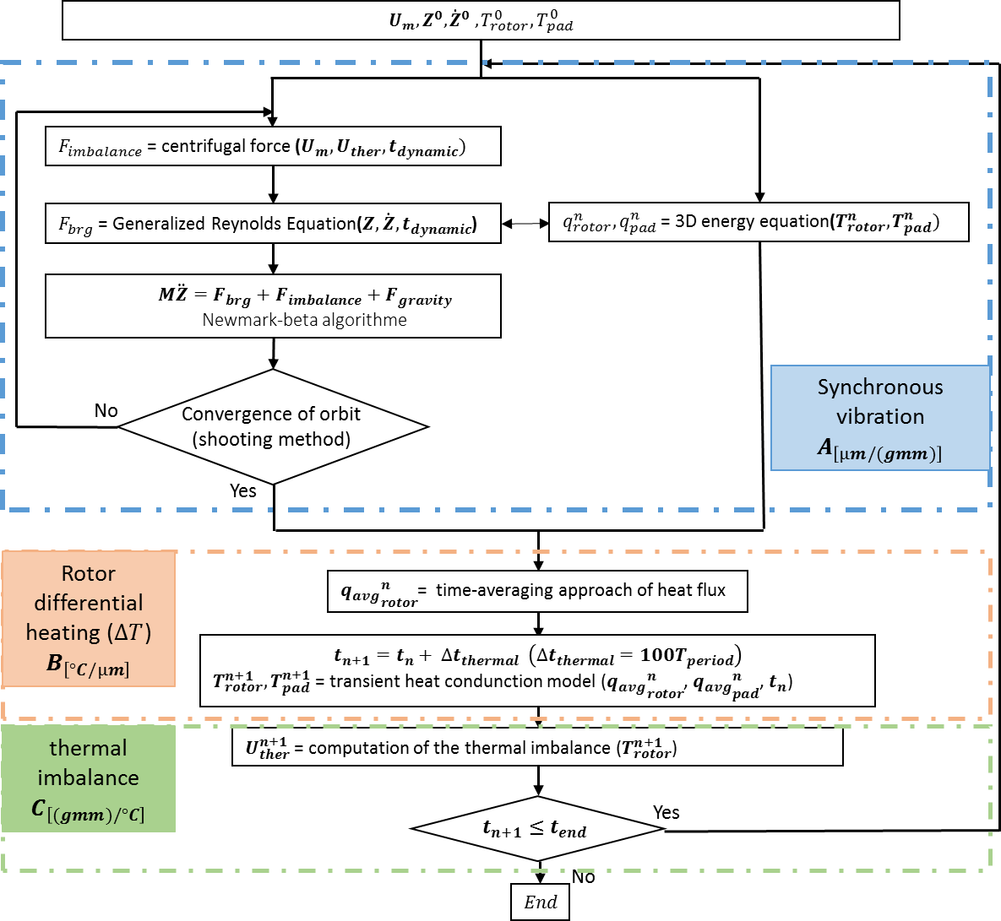

Slide 4





$$U_{m}, q^{0}, {\dot{q}}^{0} ,T_{rotor}^{0},T_{pad}^{0}$$
$F_{balourd}$ = force centrifuge ($U_{m}, U_{ther}, t_{dynamique})$
$F_{palier}$ = équation de Reynolds ($q, \dot{q},t_{dynamic}$)
$Q_{rotor}^{i}(θ_{r})$, $Q_{pad}^{i}$ = équation de l’énergie ($T_{rotor}^{i},T_{pad}^{n})$
$$M\ddot{q}=F_{palier}+F_{balourd}+F_{gravité}$$ schéma de Newmark combiné avec la méthode de Newton-Raphson
Non
Orbite périodique (méthode de shooting)
Oui
${Q_{moy}^{i}}_{rotor}$= flux thermique moyen
$$t^{i+1}=t^{i}+dt_{EM} \left(dt_{EM}=100T_{rotation}\right)$$
$T_{rotor}^{i+1}, T_{pad}^{i+1}$ = modèles thermiques (${Q_{moy}^{i}}_{rotor}$,${Q_{moy}^{i}}_{pad}$, $t^{i}$)
$q_{th}^{i+1}$ = modèle mécanique ($T_{rotor}^{i+1}$)
$U_{ther}^{i+1}$ = modèle du balourd thermique ($q_{th}^{i+1}$)
$$t^{i+1}≤t^{fin}$$
Oui
$$Fin$$
Non

Slide 5
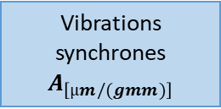
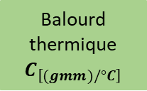

$$U_{m}, q^{0}, {\dot{q}}^{0} ,T_{rotor}^{0},T_{pad}^{0}$$
$F_{balourd}$ = force centrifuge ($U_{m}, U_{ther}, t_{dynamique})$
$F_{palier}$ = équation de Reynolds ($q, \dot{q},t_{dynamic}$)
$Q_{rotor}^{i}(θ_{r})$, $Q_{pad}^{i}$ = équation de l’énergie ($T_{rotor}^{i},T_{pad}^{n})$
$$M\ddot{q}=F_{palier}+F_{balourd}+F_{gravité}$$ schéma de Newmark combiné avec la méthode de Newton-Raphson
Non
Orbite périodique (méthode de shooting)
Vibrations synchrones
$$A_{\left[µm/(gmm)\right]}$$
Oui
Différence de temperature ($∆T$)
$$B_{\left[°C/µm\right]}$$
${Q_{moy}^{i}}_{rotor}$= flux thermique moyen
$$t^{i+1}=t^{i}+dt_{EM} \left(dt_{EM}=100T_{rotation}\right)$$
$T_{rotor}^{i+1}, T_{pad}^{i+1}$ = modèles thermiques (${Q_{moy}^{i}}_{rotor}$,${Q_{moy}^{i}}_{pad}$, $t^{i}$)
Balourd thermique
$$C_{\left[(gmm)/°C\right]}$$
$q_{th}^{i+1}$ = modèle mécanique ($T_{rotor}^{i+1}$)
$U_{ther}^{i+1}$ = modèle du balourd thermique ($q_{th}^{i+1}$)
$$t^{i+1}≤t^{fin}$$
Oui
$$Fin$$
Non

Slide 6
